Slide 1
Digital Logic Design and Application
Lecture #16
Computer overview

Slide 2
Topic 4 - Microprocessors Design
Chap7&Chap8
Dedicated Microprocessors
  Introduction
  Construct the datapath
  Construct the CU
Computer Overview
  Architecture vs. Organization
  Function & working principle
  Instruction Set Architecture
RISC CPU Design
  Specification
  ISA design
  Top-down Partition
RISC CPU Implement
  Datapath
  Control Unit
  Testbench & Verify

Slide 3
Computer Overview
Microprocessors used in Computers
  It is a typical digital circuit which composed of CU (FSM) + datapath (combinational circuit).
  Dedicated microprocessor (chap. 7)
    Hard wired, fixed function, fast
  General purpose microprocessor (chap. 8)
    Designed for executing program instructions, flexible function → CPU of a computer
Notes:
Dedicated microprocessor is like an Application Specific Integrated Circuit-ASIC. 专用（用户定制）集成电路

Slide 4
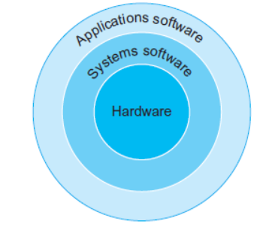
Computer hierarchy
From application and development point of view
systems soft ware:
Soft ware that provides services that are commonly useful, including operating systems, compilers, loaders, divers and assemblers.
operating system:
Handling basic input and output operations
Allocating resources(storage and memory)
Using system calls to operate CPU\RAM,I/O…
Eg. Linux, MAC, Windows.…
Compiler: A program that translates high-level language statements into assembly language statements, Machine code.
Fig. Simplified view of hardware and software as hierarchical layers
Hardware: Instruction system, exception handling mechanism（异常处理机构）.

Slide 5
Computer Architecture vs. Organization
Architecture(体系结构) is the attributes (conceptual structure, functions) visible to the programmer.
  Instruction Set（指令集）, number of bits used for data representation, I/O mechanisms, addressing techniques.
Organization（组成） is how features are implemented from viewpoint of hardware designer.
  Control signals, interfaces, memory technology.
  e.g. Is there a multiply instruction?
  e.g. Dose the multiply performed by a hardware multiply unit or by the repeated addition?

Slide 6
Computer Architecture vs. Organization
Family computers
  Same family share the same basic architecture, which gives code compatibility (At least backwards)，and differs in organization
  Different family has different Architectures
Eg. ARM11 family includes ARM1136J, ARM1156T2…
  Eg. IBM360, IBM370

Slide 7
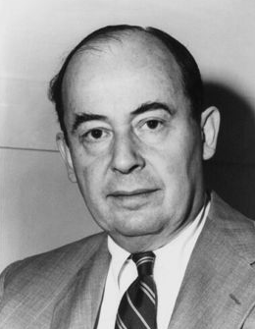
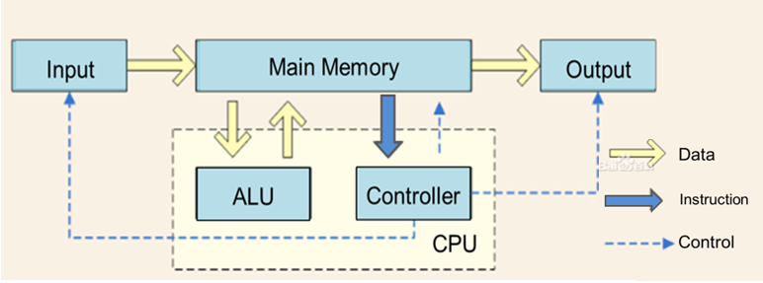
The modern computer organization
From point-view of working
Von Neumann model
stored-program computer：
I/O : User interface (eg. question, results)
ALU: Data processing
Controller : Instructions interpretation and coordination
Main memo. : information store, eg. Data, instructions…

Slide 8
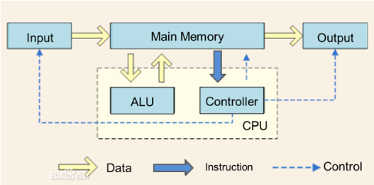
Computer Organization
From point-view of working
Center of a computer is the memory.
Data and control signals (instructions) are held in memory by binary digits.
Computers are instruction driven: pre-written programs are held in storages, when it start to work a computer automatically fetch and execute the programs in storages.

Slide 9
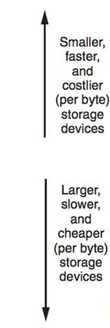

Computer storage hierarchy
CPU registers hold words operated by inside controller and data-path or retrieved from cache memo.
Registers
Cache
Mainframe
Main memory
Secondary memory
Hard disk, soft disk, CD-R

Slide 10
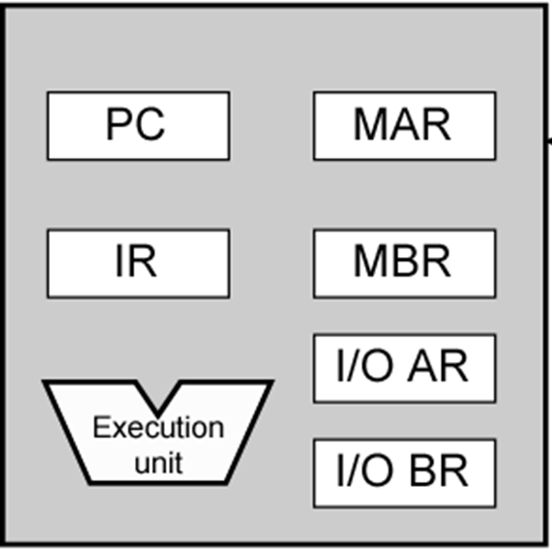
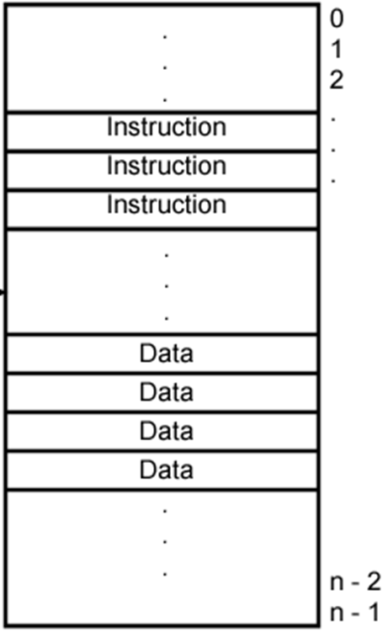
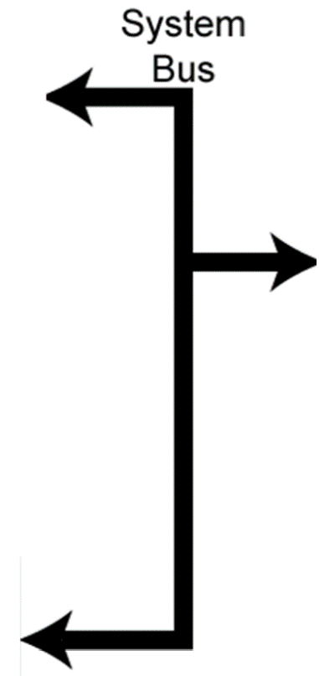
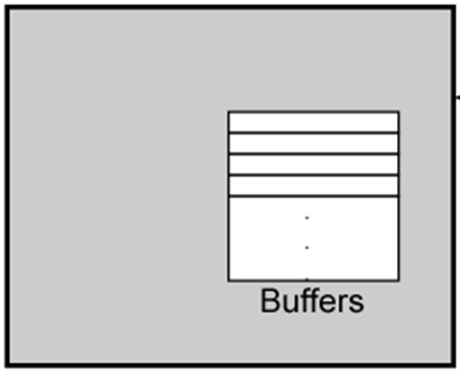
Computer Organization
Data Bus (DB):
its Width is a key determinant of performance.
CPU
Internal Bus
Memory
Buffers
Registers
Eg. 8bit*8time=64bit/time
Control
Unit
Address Bus(AB):
its width determines maximum memo/ IO capacity.
ALU
DB/AB/CB
I/O module
n-bit AB→ 2^{n} storage units
Control Bus(CB): Clock. read/write, Ready/ Busy, etc.
Fig. Modern computer
organization
Notes:
The Control Unit and the Arithmetic and Logic Unit constitute the Central Processing Unit
Data and instructions need to get into the system and results out
Input/output
Temporary storage of code and results is needed
Main memory
CPU的位数是硬件上的位数，硬件的位数其实就是指令集合的位数，硬件可以支持32指令集合或者64或者32和64都支持，比如x86－64
操作系统的位数是软件上的位数. 64位的操作系统可以安装64位和32位操作系统；32位处理器只能安装32位操作系统。
CPU的位宽:cpu的位宽暂时没有严格的定义, 一般讲: cpu的位宽 = 数据总线的位宽 = cpu内部通用寄存器的位宽 = 机器字长

Slide 11
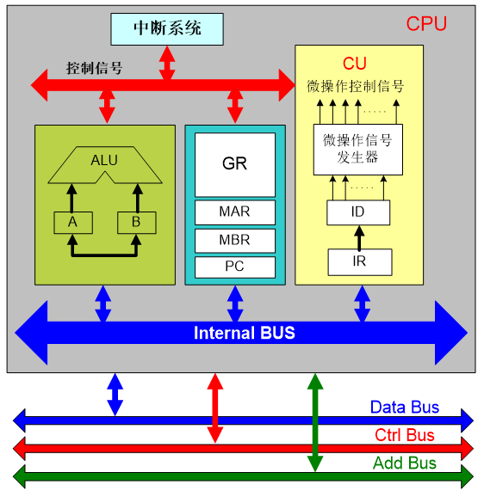
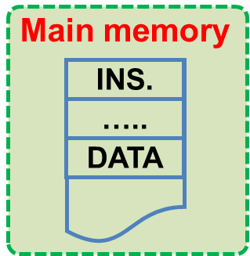
CPU Organization（CPU组成）
Interrupt sys.
ALU-Arithmetic and logic unit
GR-General Registers: limited, fast, temporary instructions, data, and address.
MAR-memory addr. register
MBR-memory buffer register
PC-program counter
CU-control unit
  ID-instruction decoder
  IR-instruction register
Control Signal
Control signals
Micro-Operation
Generator
Notes:
这里从硬链接的角度来分析CU的结构

Slide 12
Topic 4 - Microprocessors Design
Chap7&Chap8
Dedicated Microprocessors
  Introduction
  Construct the datapath
  Construct the CU
Computer Overview
  Architecture vs. Organization
  Function & working principle
  Instruction Set Architecture
RISC CPU Design
  Specification
  ISA design
  Top-down Partition
RISC CPU Implement
  Datapath
  Control Unit
  Testbench & Verify

Slide 13

Function & working principle
Execute the program (software) to implement the Data processing, Data storage, Data movement, and so on.
Program (software) is a sequence of instructions stored in main memory.
Program execution is done by circulations of instruction cycles:
  Fetch instruction （取指令）
  Execute instruction （执行指令）

Slide 14

Function & working principle
Instruction Fetch(取指令)：Read an instruction from the main memory and load it into the IR.
A 4-pipeline instruction cycle
Instruction Decode(译指令): Analysis the opcode（操作码） and decide the operations to be performed and locations of operands.
Instruction Decode
Instruction
Fetch
Micro-operations 1
Detailed instruction cycle
Modify PC, point to the next instruction.
Next Instruction Fetch
Execute
…
Write Back
Micro-operations n
Write back（写回）: store the operation result to the specific register or memory cell.
Execute(执行): calculate the address of operands and perform the operations according to opcodes（操作码）.
Notes:
译指和取数可以合并，执行和取数也可以合并

Slide 15
Function & working principle
Main memory
Address
Data
MOV 5CH, R1
④
1000H
B0H
④
Memory
Address
Decoder
(MDR)
1001H
5CH
Read
AB
③
③
1002H
XX
1003H
XX
DB
Outside of CPU
⑤
Memory Address Register (MAR)
Memory Buffer Register
Inside of CPU
①
Internal CPU Bus
①
⑥
⑥
Program Counter
(PC)
Instruction Register
Register File
R1
Temp R
Instruction Decoder
＋1
ALU
②
Sequencing Login
②
Status Register

Slide 16
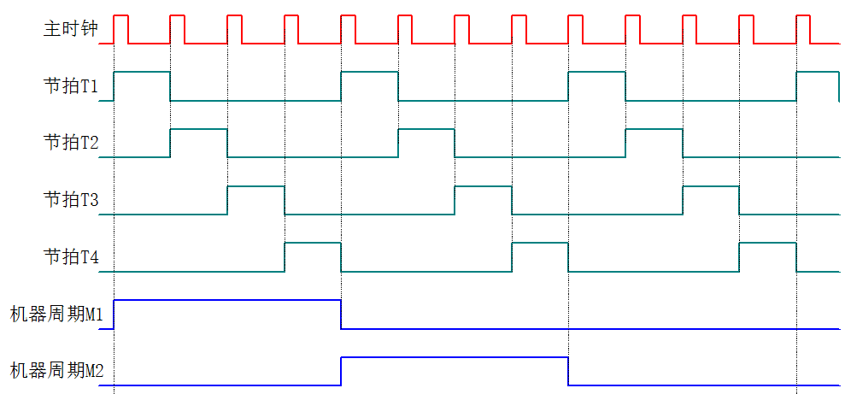

Timing of CPU working flow-Synchronized systems
CPU CLK
（时钟周期）
Working of CPU
Time-divided
Step by step
（拍）Beat T1
Beat T2
Beat T3
Beat T4
PC2MAR
MAR2Mem
Micro-ops
（微操作）
Mem2MBR
MBR2IR
Machine period M1
Machine period M2
机器周期
IF
Basic operations
ID
…
…Exe.
…WB
Instruction period
（指令周期）
Single Cycle Instruction（单周期指令）
Double Cycle Instruction（双周期指令）
Multiple Cycle Instruction（多周期指令）
Notes:
机器周期：完成一个基本操作（如取指）所需要的时间单元。
对于一些简单的的单字节指令，在取指令周期中，指令取出到指令寄存器后，立即译码执行，不再需要其它的机器周期。对于一些比较复杂的指令，例如转移指令、乘法指令，则需要两个或者两个以上的机器周期。
含一个机器周期的指令称为单周期指令，包含两个机器周期的指令称为双周期指令。

Slide 17
Instruction pipeline（指令流水）
Pipeline is the key technology to improve the efficiency and throughput of CPU operation. The idea is to overlap different procession stages of multiple instructions and make the CPU handling multiple instructions at the same time.
Divide a sequential CPU into different functional parts according to the execution stages of instructions.
  IF-ID-OF-EXE-WB
  IF-ID-EXE-WB
  IF-ID-EXE-MEM-WB
Use a set of registers to store the intermediate states of the instructions that have been processed.

Slide 18
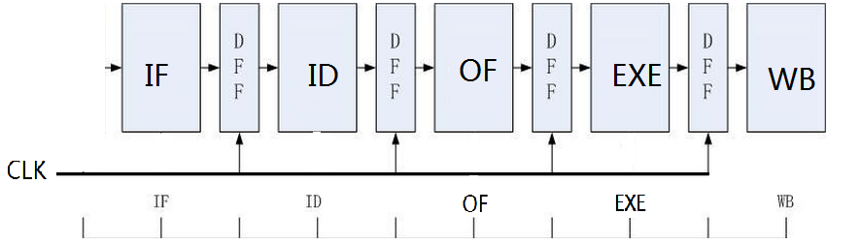
Instruction pipeline
When the first instruction enters into its next procession stage, the processing of the second instruction can be performed at the same time.
1st instruction
  A 5-level Pipeline for instruction execution

Slide 19
Instruction pipeline
When the first instruction enters into its next procession stage, the processing of the second instruction can be performed at the same time.
2nd instruction
1st instruction
  A 5-level Pipeline for instruction execution

Slide 20
Instruction pipeline
When the first instruction enters into its next procession stage, the processing of the second instruction can be performed at the same time.
1st instruction
2nd instruction
  A 5-level Pipeline for instruction execution

Slide 21
Instruction pipeline
When the first instruction enters into its next procession stage, the processing of the second instruction can be performed at the same time.
2nd instruction
3nd instruction
1st instruction
  A 5-level Pipeline for instruction execution

Slide 22
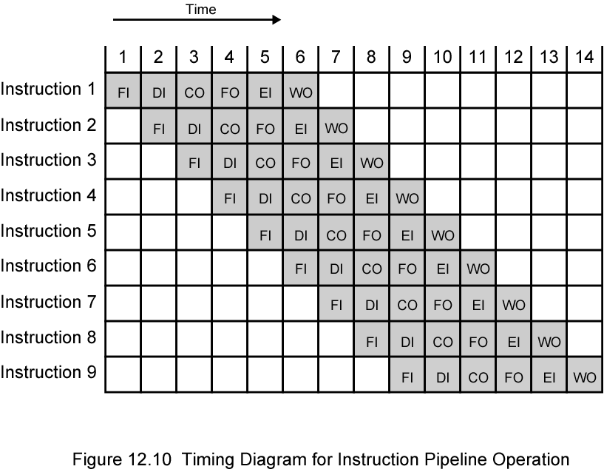
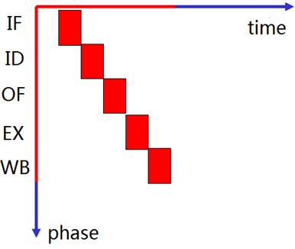


Instruction pipeline
Pipeline execution
Sequential execution
2 instructions executed within 10 period
5 instructions executed within 10 period
The efficiency and throughput of CPU operation is greatly raised.

Slide 23
Computer Performance Measure
It is a complicated measurement
  Software, hardware
CPU performance
  Speed
  Word width
  storage
Notes:
计算机系统的性能由硬件性能和程序特性决定

Slide 24
CPU Performance Measure
CPU clock frequency
  Not directly related to the CPU or computer performance.
Word length
  The bit width of data that can be processed each time by CPU, usually it equals to the internal Data Bus width.
Eg. 64 bit/time = 8bit/time * 8 time
The rate at which it executes Benchmarks.
  Millions of instructions per second (MIPS), for CPU hardware performance
  Millions of floating point instructions per second (MFLOPS)
Execution time ( T )
  users care most，for both hardware and software performance.
Notes:
Cpu主频：目前英特尔 i7 9700K采用8核心8线程的设计，拥有3.6GHz主频，
计算机系统的性能由硬件性能和程序特性决定，通常可利用标准测试程序来测定性能。
用MIPS (Million Instructions Per Second,每秒百万条指令)或MFLOPS(每秒百万次浮点操作)的数值来衡量计算机系统的硬件速度。
用 CPU执行时间T来量化硬软件结合系统的有效速度。
Benchmarks：Programs designed to test performance。Written in high level language。E.g. System Performance Evaluation Corporation (SPEC)
CPU2006 for computation bound
17 floating point programs in C, C++, Fortran
12 integer programs in C, C++
3 million lines of code
Speed and rate metrics
Single task and throughput

Slide 25
CPU Performance Measure
Millions of instructions per second (MIPS)
  Based on the statistic time cost on executing benchmarks.
MIPS rate = f * IPC= f(MHz) / CPI
T =IC* CPI /f (Hz)= IC/ [IPC*f (Hz)]= IC/ MIPS
    f is processor clock frequency
    IPC is average instructions per cycle, usually <1
    CPI is average cycles per instruction, usually >1
    IC is total instruction count
Increase performance by increasing clock frequency and increasing instructions that complete during cycle.
May be reaching limit.
  Complexity , Power consumption.
Notes:
MIPS：衡量CPU的硬件速度
T：衡量软硬件结合系统的有效速度。
CPI（Cycles Per Instruction）：指令执行的平均周期数，可从运行大量测试程序或实际程序产生的统计数据中计算出来 。CPI数越小,CPU速度越快。
指令周期 instruction cycle
CPU取出一条指令并执行该指令所需的时间称为指令周期。 指令周期的长短与指令的复杂程度有关，指令周期常常用若干个CPU周期数来表示。任何一条指令，它的指令周期至少需要两个CPU周期，而复杂指令的指令周期则需要更多的CPU周期。这是因为，一条指令的取出阶段需要一个CPU周 期时间，而一条指令的执行阶段则需要至少一个CPU周期时间。由于不同复杂度指令的执行周期所需的CPU周期数不尽相等，因此，各种指令的指令周期也是不 尽相同的。

Slide 26
Computer performance assessment
Consider the execution of a program which results in the execution of 2 million instructions on a 400-MHz processor. The program consists of four major types of instructions. The instruction mix and the CPI for each instruction type are given below based on the result of a program trace experiment. Please give out the average CPI , the corresponding MIPS and the execution time T when the program is ran on a uniprocessor .
average cycles per instruction
Instruction Type | CPI | Instruction Mix
Arithmetic and logic | 1 | 60%
Load/store with cache hit | 2 | 18%
Branch | 4 | 12%
Memory reference with cache miss | 8 | 10%
CPI = 0.6 + (2 * 0.18) + (4 * 0.12) + (8 * 0.1) = 2.24
MIPS =(400 * 10⁶) / 2.24 = 178 (M)
T= 2* 10⁶ *2.24/(400 * 10⁶) = 0.0112 (s)
Or T= 2 M / 178 M= 0.0112 (S)

Slide 27
Topic 4 - Microprocessors Design
Chap7&Chap8
Dedicated Microprocessors
  Introduction
  Construct the datapath
  Construct the CU
Computer Overview
  Architecture vs. Organization
  Function & working principle
  Instruction Set Architecture
RISC CPU Design
  Specification
  ISA design
  Top-down Partition
RISC CPU Implement
  Datapath
  Control Unit
  Testbench & Verify

Slide 28
Instruction and Instruction Set
Instruction
In machine code, each instruction has a unique bit pattern.
For human consumption (programmers)
  symbolic representation
  C/C++ representation……
1100 001 010 011
A = B + 10011
Instruction Set Architecture ( ISA-指令集架构)
The complete collection of instructions understood and implemented by a CPU (hardware).
Binary Machine Code. Usually represented by assembly codes.
Interface between the Software and Hardware.
ADD R0, R2, 10011
Notes:
2
ISA is the part of the processor that is visible to the programmer or compiler writer. The ISA serves as the boundary between software and hardware.

Slide 29
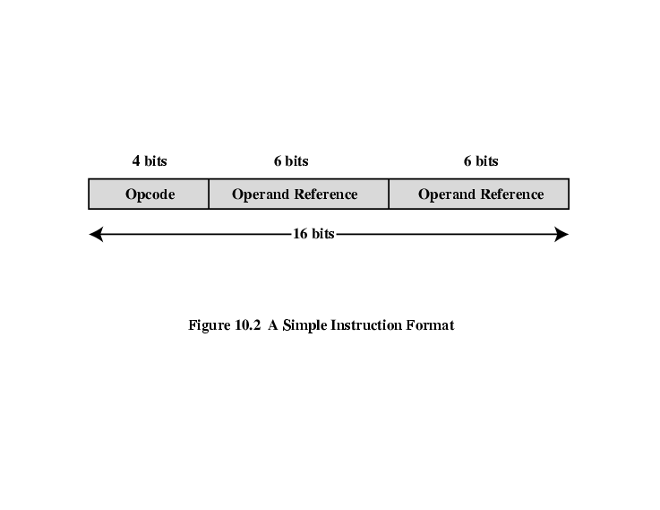
Elements of an Instruction
Chap8.1
Operation code (Opcode)
  Do this
Source Operand reference
  Take this
Result Operand reference
  Put the answer here
Next Instruction Reference
  What to do next
Determine the types of data process,
and the software feature of CPU.
Eg. ADD, MOV….
Also named Address mode reference;
Determine the data store methods,
and the hardware feature of CPU;
Usually implied when next instruction is exactly followed the current instruction;
Otherwise determine the address offset of next instruction;
Fig. Simple Instruction Format
Notes:
3

Slide 30
ISA Design Decisions
ISA determines the function assignment between the software and hardware.
  For programmers: ISA is instructions they can use and specifications they must follow when writing programs.
  For CPU designers: Based on the ISA to design the processor .
  Eg. Is there a multiply instruction? If no, then multiplication must done through a program.
  Eg. There is a hardware performs multiplication.
Main considerations: Speed, cost and flexibility.
  Software implemented: slow, inexpensive, flexible
  Hardware implemented: fast, expensive, in-flexible
Notes:
12
指令集结构(ISA)是体系
结构的主要内容之一，其功
能设计实际就是确定软硬件
的功能分配。
考虑因素 速度、成本和灵活性
实现方式 硬件、软件
优化策略 RISC、CISC；流水线；多核；……
实现内容 数据类型、指令功能、指令格式、寻址方式
实现步骤
根据应用初拟出指令的分类和具体的指令；
编写出针对该指令系统的各种高级语言编译程序；
对多种算法程序进行模拟测试，确认指令系统的操作码和寻址方式的效能是否都比较高；
用硬件实现高频使用的指令，软件实现低频使用指令

Slide 31
ISA Design Decisions
Operation repertoire
  What can they do?
  How complex are they?
Operand:
  Data types
  Addressing modes
      Number of CPU registers available.
      Which operations can be performed on which registers?
      Can the output of ALU send to memory?
Instruction formats
  Length of op code field: How many ops?
  Number of addresses: How many operands?
  What can they do?
Notes:
12
指令集结构(ISA)是体系
结构的主要内容之一，其功
能设计实际就是确定软硬件
的功能分配。
考虑因素 速度、成本和灵活性
实现方式 硬件、软件
优化策略 RISC、CISC；流水线；多核；……
实现内容 数据类型、指令功能、指令格式、寻址方式
实现步骤
根据应用初拟出指令的分类和具体的指令；
编写出针对该指令系统的各种高级语言编译程序；
对多种算法程序进行模拟测试，确认指令系统的操作码和寻址方式的效能是否都比较高；
用硬件实现高频使用的指令，软件实现低频使用指令

Slide 32
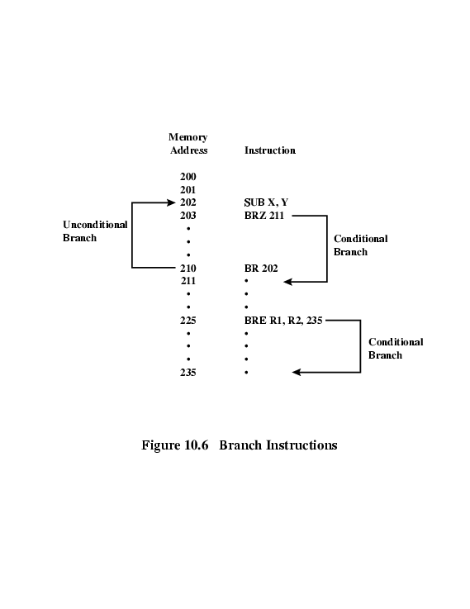
Types of Operations (Instructions)
  Data Transfer
  Specify
    Source, Destination, Amount of data
  May be different instructions for different address
    Register, Memory, I/O
  Data transfer from/to I/O
    May be specific instructions;
    May be done based memory mapped;
    May be done by a separate controller (DMA)
  Control (Program flow )
  Branch/Jump
    Conditional branch
    Unconditional branch
  Subroutine call
  interrupt call
Data processing
  Arithmetic
    Add, Subtract, Multiply, Divide
    Signed Integer
    Floating point
    May include:
    Increment (a++),Decrement (a--),Negate (-a)
  Logical
    Bitwise operations
    AND, OR, NOT
Notes:
18
指令按功能可分成以下三种基本类型：
数据传输：将数据从一个地方（源地址）复制到另一个 地方（目的地址），传输结束后源地址中的内容不变。
数据传送范围： R->R、R->M、M->R或M->M, I/O？
数据传送宽度：一般为固定值（如8、16或32bit），其 它宽度的数据传送一般可通过软件移位和合 并操作来实现。
数据运算：包括算术运算（加、减、乘、除等）和逻辑 运算（与、或、非、异或等）。
该类指令需要明确操作数的类型和长度。
控制类：用于改变正常的程序执行流程，完成程序的跳转 ，主要包括转移指令和过程指令。

Slide 33
ISA Design Decisions
ISA determines the function assignment of the software and hardware
Operation repertoire['repətwɑː]
  What can they do?
  How complex are they?
Operand:
  Data types
  Addressing modes
      Number of CPU registers available.
      Which operations can be performed on which registers?
      Can the output of ALU send to memory?
Instruction formats
  Length of op code field: How many ops?
  Number of addresses: How many operands?
RISC or CISC?
Notes:
12
指令集结构(ISA)是体系
结构的主要内容之一，其功
能设计实际就是确定软硬件
的功能分配。
考虑因素 速度、成本和灵活性
实现方式 硬件、软件
优化策略 RISC、CISC；流水线；多核；……
实现内容 数据类型、指令功能、指令格式、寻址方式
实现步骤
根据应用初拟出指令的分类和具体的指令；
编写出针对该指令系统的各种高级语言编译程序；
对多种算法程序进行模拟测试，确认指令系统的操作码和寻址方式的效能是否都比较高；
用硬件实现高频使用的指令，软件实现低频使用指令

Slide 34
RISC vs. CISC
CISC（Complex Instruction Set Computer )
For many years, the general trend in computer architecture and organization has been toward increasing processor complexity:
  Large instruction sets, more addressing modes
  More specialized registers
  Improve flexibility, support more complex high-level languages
  Ease compiler designing, complex operations in microcode
RISC（Reduced Instruction Set Computer)
  Studies of the execution behavior of high-level language programs have provided guidance in designing RISC architecture:
  Few, simple instruction formats & addressing modes
  large number of general purpose registers
  Improve execution efficiency by pipeline (one instruction per cycle)
  More compile time/effort, hardwired design (no microcode)
Which is better?
Not clear cut. Many designs borrow from both philosophies.
Notes:
In more recent years, the RISC versus CISC controversy has died down to a great extent.This is because there has been a gradual convergence of the technologies.
As chip densities and raw hardware speeds increase, RISC systems have become more complex. At the same time, in an effort to squeeze out maximum performance, CISC designs have focused on issues traditionally associated with RISC, such as an increased number of general-purpose registers and increased emphasis on instruction pipeline design.

Slide 35
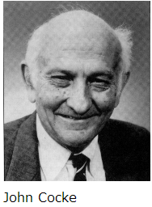
RISC vs. CISC
In 1975, IBM's designer John Cocke studied the IBM 370 CISC system. Found that , 80% of the program calls use only 20% simple instructions of the total instructions.
Function of a complex instruction could be realized by several simple instructions.
Collabrated with R. Andrew Heller, he put forward the concept of RISC ( Reduced Instruction Set Computer).
(30 May 1925-16 July 2002)

Slide 36
RISC vs. CISC
In general, CISC has more instructions and a complex architecture. It's relatively slower per instruction, but optimized for the programmer because a task can be accomplished by fewer instructions.
On the other hand, RISC has fewer, faster instructions and a simpler architecture. It's easier to write powerful optimized compilers since fewer instructions exist, but more instructions are needed to accomplish a same task.
x86, C51
arm, mips, powerpc, avr, pic

Slide 37
ISA Design Decisions
ISA determines the function assignment of the software and hardware
Operation repertoire
  What can they do?
  How complex are they?
Operand:
  Data types
  Addressing modes
      Number of CPU registers available.
      Which operations can be performed on which registers?
      Can the output of ALU send to memory?
Instruction formats
  Length of op code field: How many ops?
  Number of addresses: How many operands?
Notes:
12
指令集结构(ISA)是体系
结构的主要内容之一，其功
能设计实际就是确定软硬件
的功能分配。
考虑因素 速度、成本和灵活性
实现方式 硬件、软件
优化策略 RISC、CISC；流水线；多核；……
实现内容 数据类型、指令功能、指令格式、寻址方式
实现步骤
根据应用初拟出指令的分类和具体的指令；
编写出针对该指令系统的各种高级语言编译程序；
对多种算法程序进行模拟测试，确认指令系统的操作码和寻址方式的效能是否都比较高；
用硬件实现高频使用的指令，软件实现低频使用指令

Slide 38
Types of Operand (Data)
x86 Data Types
8 bits Byte, 16 bits word, 32 bits double word
64 bits quad word, 128 bits double quad word
Words do not need to align at even address
double word read at addresses divisible by 4
32 bits data bus
addressing is by 8 bits unit
Little Endian
Numbers
  Unsigned Integer
  Signed Integer
  Floating point
Characters
  ASCII etc.
  String
Logical Data
  Bit
  Flags
ARM Data Types
8 bits Byte, 16 bits halfword, 32 bits word;
Halfword and word accesses should be word aligned
Majority of implementations do not provide floating-point hardware
  Saves power and area
  Floating-point arithmetic implemented in software
  Optional floating-point co-processor
32 bits data bus
addressing is by 8 bits unit
  Little Endian or Big Endian determined by software
Notes:
14
确认某种特殊类型的数据是否应该得到硬件支持
数值型数据：无符号整数、带符号整数、浮点数
非数值数据：字符串
确认字长（对数据长度的限制）
截断（truncation）或溢出（overflow）
在选择数据格式和长度时需要平衡数值范围、程序执行期间发生溢出的可能性、处理设备和存储设备的复杂性、以及价格和速度等因素。

Slide 39
ISA Design Decisions
ISA determines the function assignment of the software and hardware
Operation repertoire
  How complex are they?
  What can they do?
Operand:
  Data types
  Addressing modes
      Number of CPU registers available.
      Which operations can be performed on which registers?
      Can the output of ALU send to memory?
Instruction formats
  Length of op code field: How many ops?
  Number of addresses: How many operands?
Notes:
12
指令集结构(ISA)是体系
结构的主要内容之一，其功
能设计实际就是确定软硬件
的功能分配。
考虑因素 速度、成本和灵活性
实现方式 硬件、软件
优化策略 RISC、CISC；流水线；多核；……
实现内容 数据类型、指令功能、指令格式、寻址方式
实现步骤
根据应用初拟出指令的分类和具体的指令；
编写出针对该指令系统的各种高级语言编译程序；
对多种算法程序进行模拟测试，确认指令系统的操作码和寻址方式的效能是否都比较高；
用硬件实现高频使用的指令，软件实现低频使用指令

Slide 40
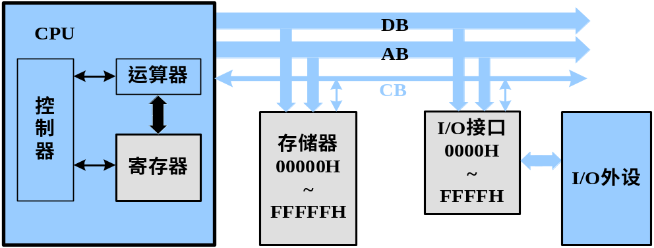
Address Mode Design Decisions
Where have all the Operands Come or Gone?
Main memory
CPU register
I/O device
More addresses
  More complex (powerful?) instructions
  Fewer instructions per program
  More registers
    Inter-register operations are quicker
Fewer addresses
  Less complex (powerful?) instructions
  More instructions per program
  Faster fetch/execution of instructions
Notes:
4
(If you don’t understand, you’re too young!)

Slide 41
Data Transfer Decisions
IR
ID
ALU
MEM
REG
CISC (Intel)
IR
ID
ALU
MEM
REG
RISC (ARM)
LOAD/STORE:
Only instructions that reference memory

Slide 42
Addressing Modes
Operand is in Register
  Immediate
  Register direct
Operand is in Memory(I/O)
  Memo. Direct
  Register Indirect
  Memo. Indirect
  Memo. Displacement
Notes:
2

Slide 43
Addressing Modes
Operand is in Register
  Immediate
  Register Direct
Operand is in Memory(I/O)
  Memo. Direct
  Register Indirect
  Memo. Indirect
  Memo. Displacement
Notes:
2

Slide 44
Immediate Addressing(立即寻址)
Operand is a part of instructions.
Fast: No memory access
Limited range: Limited instruction length
Sign extension may needed
ADD
Rd
Rs1
imm
(in Instruction Register)
ADD Rd, Rs1, #imm
; Rd ← (Rs1) + imm (sign expended)
Use an instruction field to store the operand
Notes:
3

Slide 45
Register Direct addressing (寄存器直接寻址)
Operand is held in register, instruction contains address of the register.
Fast: No memory access
Limited number of registers
  Multiple registers helps performance
  Requires good assembly programming or compiler writing
  Shorter instructions: Very small address field needed
ADD
Rd
Rs1
imm
Registers File
ADD Rd, Rs1, #imm
Source Operand
Rd ← (Rs1) + imm (sign expended)
Result Operand
Use a register to store the operand
Notes:
10

Slide 46
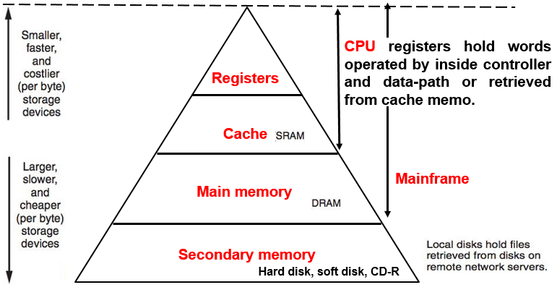
Addressing Modes
Operand is in Register
  Immediate
  Register Direct
Operand is in Memory(I/O)
  Memory Direct
  Register Indirect
  Memo. Indirect
  Memo. Displacement
Eg. Large DataBase
Notes:
2

Slide 47
Memory Direct Addressing(内存直接寻址)
Operand is held in memory, instruction contains a immediate number to represent the memory address of the operand.
Single memory reference to access data
No additional calculations to work out effective address
Limited address space
LDR
Rd
addr
LDR Rd, [addr]
Memory
pointer
Source Operand
Rd ← mem[addr]
Use an instruction field to store the address of the operand
Notes:
5
Effective address (EA) = address field (A)
e.g. ADD A
Add contents of cell A to accumulator
Look in memory at address A for operand

Slide 48
Register Indirect Addressing (寄存器间接寻址)
Operand is held in memory, instruction contains the code of register which holding the address of the operand.
Registers are used as addressing registers
Large address space (2^{n}，n is the width of Registers)
STR
Rs
Rd
STR Rs, [Rd]
Registers
Memory
pointer
pointer
Address
Destination Operand
mem[(Rd)] ← Rs
Use a register to store the address of the operand
Notes:
7
C.f. indirect addressing
EA = (R)
Operand is in memory cell pointed to by contents of register R

Slide 49
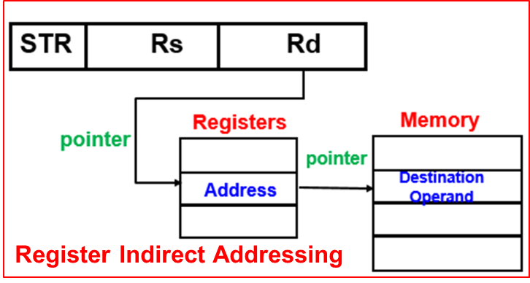
Memory Indirect Addressing
Operand is held in memory, instruction contains the address of the pointer which point to the operand.
  Multiple memory accesses to find operand, Hence slower
  Large address space
May be nested, multilevel, cascaded
  Used for Lookup table or Jump table
Like a pointer of pointer in C language
ADD
Rd
Rs1
addr
Memory
Source Operand
ADD Rd, Rs1, [addr]
pointer
pointer
Address
Rd ← (Rs1) + mem[[addr]]
Use a memo. unit to store the address of the operand
Notes:
7
EA = (A)
Look in A, find address (A) and look there for operand
e.g. ADD (A)
Add contents of cell pointed to by contents of A to accumulator
e.g. EA = (((A)))
Draw the diagram yourself

Slide 50
Memo. Displacement Addressing
Operand is held in memory, and to avoid usage of absolute address，address of operand contains two parts:
  Operand Address=base-value+displacement (offset)
  Relative addressing: The address offset is held in an immediate.
  Index addressing: The address offset is held in an register.
Notes:
15
EA = A + (R)
A= base value
R= register that holds displacement
or vice versa

Slide 51
Memo. Displacement Addressing
relative addressing Addressing:
the address base value is held in base-register Rs and the address offset is held in instruction by an immediate .
immediate ← program label
Rs ← branch information,
Eg. Rs ← Rs+4
Good for Branch instruction
MOV
Rd
Rs
addr
Memory
base
offset
Source Operand
Registers File
I (0)
I(1)
MOV Rd, addr[Rs]
address base
+
pointer
I(1)
I(3)
…
Rd ← mem[(Rs)+mem[addr]]
I(n-1)

Slide 52
Memo. Displacement Addressing
Indexed Addressing:
  The base value is held in base-register Rs and the offset is held in index-register Rx.
  Used for accessing arrays
Rs ← start addr. of an array
Rx++ (or Rx--)
ADD
Rd
RS1
Rs
Rx
base
offset
Memory
Registers File
pointer
Source Operand
ADD Rd, RS1, addr[Rs+Rx]
A(0)
address base
+
Rd ← RS1+mem[(RS)+(Rx)]
A(1)
address offset
…
A(n-1)

Slide 53
ISA Design Decisions
ISA determines the function assignment of the software and hardware
Operation repertoire
  What can they do?
  How complex are they?
Operand:
  Data types
  Addressing modes
      Number of CPU registers available.
      Which operations can be performed on which registers?
      Can the output of ALU send to memory?
Instruction formats
  Length of op code field: How many ops?
  Number of addresses: How many operands?
Notes:
12
指令集结构(ISA)是体系
结构的主要内容之一，其功
能设计实际就是确定软硬件
的功能分配。
考虑因素 速度、成本和灵活性
实现方式 硬件、软件
优化策略 RISC、CISC；流水线；多核；……
实现内容 数据类型、指令功能、指令格式、寻址方式
实现步骤
根据应用初拟出指令的分类和具体的指令；
编写出针对该指令系统的各种高级语言编译程序；
对多种算法程序进行模拟测试，确认指令系统的操作码和寻址方式的效能是否都比较高；
用硬件实现高频使用的指令，软件实现低频使用指令

Slide 54
Number of Addresses
3 addresses
  Operand 1, Operand 2, Result
  May be a forth -next instruction (usually implicit)
  Needs very long words to hold everything
ADD R0,R1,R2
2 addresses
  One address doubles as operand and result
  Reduces length of instruction
  Requires some extra work
    Temporary storage to hold some results
ADD R0,R1
1 address
  Implicit second address
  Usually a register (accumulator)
  Common on early machines
ADD R0
0 (zero) addresses
  All addresses implicit
  Uses a stack
  PUSH A
  PUSH B
  ADD
  POP C
Notes:
7

Slide 55
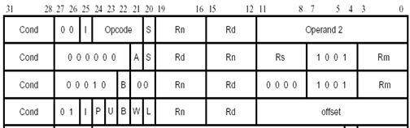
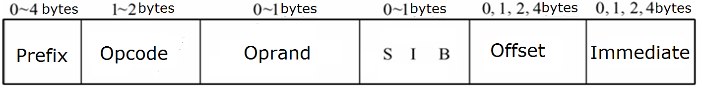
ARM(RISC) vs. x86(CISC)
ADDS R0,R1,R2
ADDHI R0, R0, #1
ARM
x86
ADD AX,BX
ADD AX,[20H]
ADD BYTE PTR [20H], 1
Notes:
到此为止，可算第二个Lecture的内容。
1。RISC指令规则，适合流水设计
2。寻址方式灵活简单，执行效率高
3。所有指令的条件执行实现最快速的代码执行
4。支持Thumb（16 位）/ARM（32 位）双指令集，能很好的兼容8 位/16 位器件
1。为保持兼容性采用变长的、高度不规则的CISC指令集。
2。是基于专用寄存器组的二地址存储器-寄存器(M-R)机：对于二元操作，一个操作数总是指定在寄存器中，另一个操作数可以从存储器或寄存器中读取

Slide 56
Required reading
  Computer Organization and Architecture Design for Performance
  William Stallings, 8th Edition
      Chapter 3, A Top-level View of Computer Function and Interconnection
      Chapter 9, Computer Arithmetic
      Chapter 10, Instruction Sets: Characteristics and Functions
      Chapter 11, Instruction Sets: Addressing Modes and Formats
      Chapter 12, Processor Structure and Function
      Chapter 15, Control Unit Operation
  微处理器系统原理与嵌入式系统设计（第二版） 李广军，阎波等, 电子工业出版社
      Chapter 2，计算机系统的结构组成与工作原理
      Chapter 3，微处理器体系结构及关键技术
  数字系统设计（Verilog and VHDL）Enoch O Hwang，电子工业出版社
      Chapter 8

